Slide 1

Woodchipper Design
Machine Elements 2 | Market Research, Calculation & Design Plan
Nipun Gunarathne
Antony Akwalu
Levente Cseszkó
Gaurawa Kovida

Slide 2
Project Scope & Objectives
To design, calculate, and document a complete, safe, and mobile woodchipper based on the provided 7.5 kW motor specification.

Slide 3







Core Project Requirements
Cutter & Housing
Drivetrain Calculation
Frame & Mobility
Safety & Function
Design a disc cutter, main shaft, and protective housing. Target 50mm branch capacity.
Calculate and document the full power transmission: belt drive, shaft loads, and bearing selection.
Create a stable sheet metal frame on a mobile platform for transport and operation.
The final design must be functional, with all guards and safety features included.

Slide 4
Market Research
Analyzing the "Prosumer" (7.5 kW) woodchipper market to establish our design philosophy.

Slide 5


Market Analysis: Competing Designs
1. High-Speed / Low-Torque (Budget)
2. Moderate-Speed / High-Torque (Premium)
These are often direct-driven from 3600 RPM petrol engines, spinning the cutter at 2200-3000+ RPM.
Uses a deliberate belt reduction from a high-speed motor to run the cutter at 1300-2000 RPM.
Pros: Cheap to build (no reduction), lighter flywheel.
Pros: Vastly superior torque, ideal for a heavy flywheel, powers through tough wood, and longer component life.
Cons: Lower torque (stalls on 50mm+ wood), high noise, and faster wear on knives and bearings.
Cons: Requires a heavier disc and a calculated drive system.

Slide 6
Our Philosophy: Engineer for Torque
2x
Why 1460 RPM is the Smart Choice
The law of power is P = T · ω (Power = Torque × Speed).
By using a 2:1 belt reduction (2920 RPM → 1460 RPM), we halve the speed but double the available torque at the cutter disc. This high torque, combined with a heavy flywheel, allows our 7.5 kW motor to easily chip 50mm branches without stalling.
More Torque

Slide 7
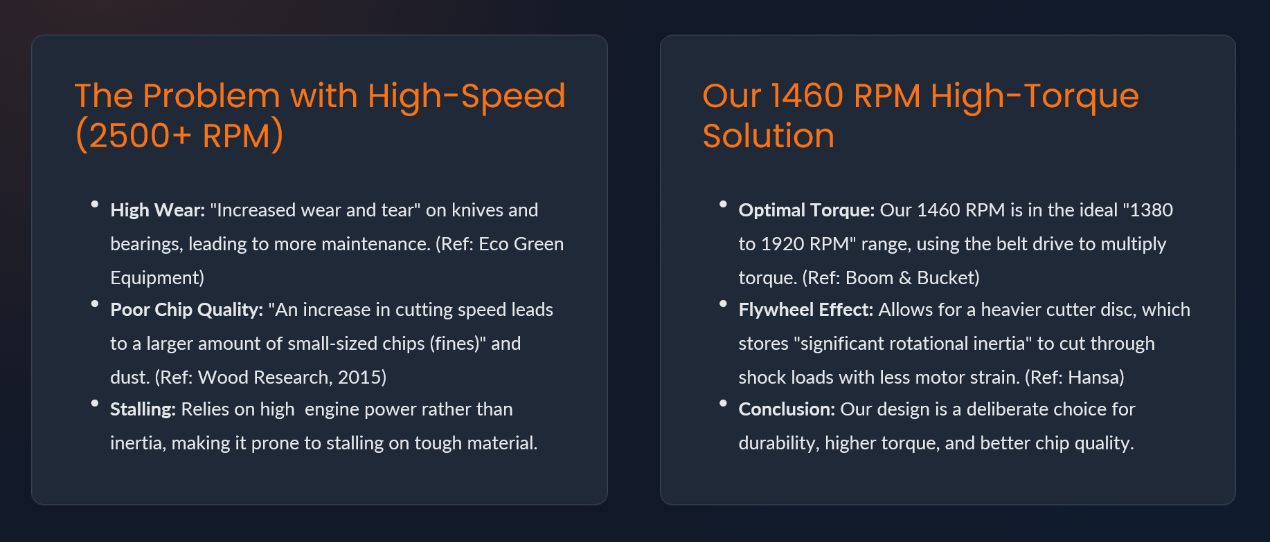
Design Justification

Slide 8
Drivetrain Design & Calculation
Translating our philosophy into a calculated, engineered system. (Ref: Optibelt Technical Manual)

Slide 9
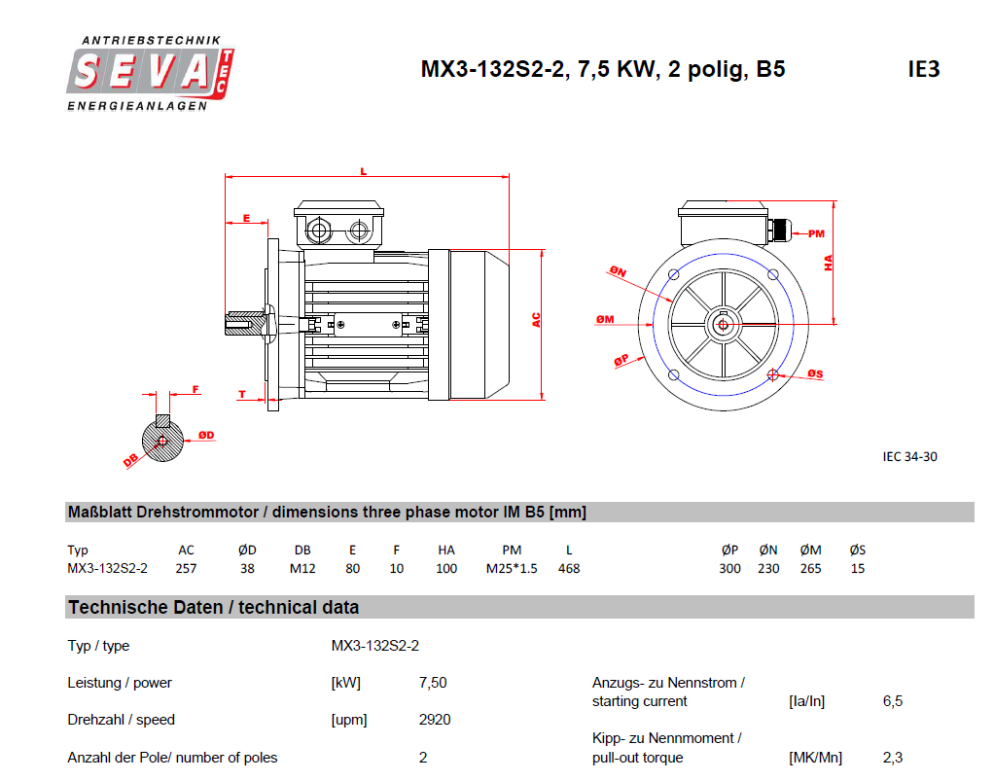
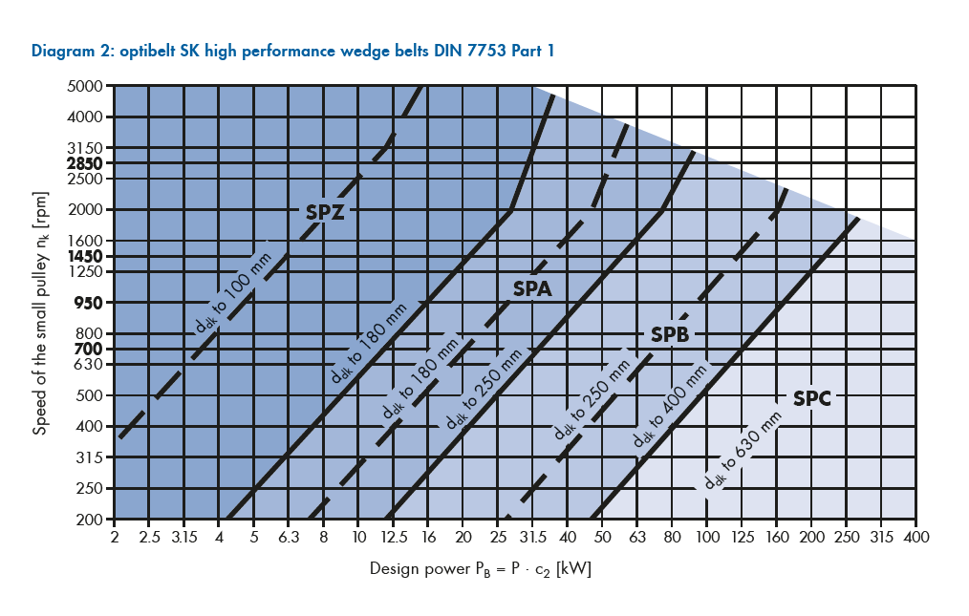
Step 1: Design Power (P_{B}) & Belt Profile
A Service Factor of 1.6 is selected for a heavy-duty, 16+ hour operation with shock loads (per Optibelt Table 23).
Requirement: 7.5 kW Electric motor
As per the Optibelt catalogue, SPZ V belts are used.
(Design power 7.5*1.6= 12 kW)

Slide 10
Step 2: Pulleys, Belt Length & Ratios
Parameter | Symbol | Value | Notes
Motor Speed (n₁) | n₁ | 2920 RPM | From SEVA-tec motor specs.
Target Cutter Speed (n₂) | n₂ | 1460 RPM | Project requirement.
Target Gear Ratio | i | 2.0 | -
Small Pulley (Motor) | d_{dk} | 106 mm | Standard SPZ Taper-Lock size.
Large Pulley (Cutter) | d_{dg} | 212 mm | Standard SPZ Taper-Lock size.
Std. Belt Length | L_{dst} | 1500 mm | Selected for standard center distance= 497.6 mm (in range).

Slide 11
Step 3: Number of Belts (z) & Sanity Checks
Parameter | Symbol | Value | Notes
Belt Speed | v | 16.2 m/s | PASSED. (Limit: 42 m/s for SPZ)
Flex Rate | f_{b} | 21.6 Hz | PASSED. (Limit: 100 Hz)
Nominal Power / Belt | P_{N} | 4.8 kW | Optibelt Table 41 (SPZ, 106mm, 2920rpm)
Correction Factors | c₁,c₃ | 0.99 | From the catalogue
Calculated Belts | z | 2.57 | -
Final Selection | z_{dst} | 3 Belts | Always round up. (SPZ 1500)

Slide 12
Step 4: Cutter Disc Sizing (Tip Speed)
Parameter | Symbol | Value | Notes
Design Requirement | V_{c} | > 25 m/s | Minimum tip speed for effective chip ejection (Ref: Reczulski, 2015).
Min. Diameter | D_{min} | 327 mm | Using the given equations.
Selected Diameter | D_{dst} | 400 mm | Selected for higher inertia (flywheel effect).
Final Tip Speed | V_{c} | 30.58 m/s | PASSED.

Slide 13
Step 5: Shaft Load Analysis (Moments)
Parameter | Symbol | Value | Notes
Max. Shaft Load (from Step 3) | S_{max} | 1158 N | This is the peak bending force F from the belts.
Torsional Moment (Torque) | M_{t} | 49.2 Nm | -
Assumed Overhang | a | 60 mm | Assumed distance from bearing to pulley center.
Bending Moment | M_{b} | 69.5 Nm | -
Equivalent Torque | T_{e} | 85.15 Nm | Combines both loads.

Slide 14
Step 6: Shaft Diameter Calculation (d)
Parameter | Symbol | Value | Notes
Material | - | C45 Steel | Good strength and machinability.
Shear Yield Strength | t_{y} | ~170 MPa | -
Factor of Safety | n | 4.0 | High value chosen for shock/impact loads.
Allowable Shear Stress | t_{allow} | 42.5 MPa | -
Min. Required Diameter | d_{min} | 21.7 mm | -
Final Selected Diameter | d | 35 mm | Standard size, accounts for keyway & shock.

Slide 15
Step 7: Keyway Sizing (for 35mm Shaft)
Parameter | Symbol | Value | Notes
Standard Key (DIN 6885) | b*h | 10mm x 8mm | For a 35mm shaft.
Allowable Pressure | p_{allow} | 60 MPa | Conservative value for shock loads.
Shaft Keyway Depth | t₁ | 5 mm | Standard for 8mm high key.
Min. Length (Pressure) | l_{p} | 15.87 mm | -
Min. Length (Shear) | lt | 4.76 mm | Shear is not the limiting factor.
Final Key Selection | - | 10x8x25 mm | 25mm is a standard length > 15.87mm.

Slide 16
Calculation Summary: Final Design Values
Component | Parameter | Final Selected Value
Motor | Power / Speed | 7.5 kW / 2920 RPM
Cutter Disc | Diameter / Speed | 400 mm / 1460 RPM
Belt Drive | Type / Quantity | 3 x SPZ 1500 V-Belts
Pulleys | Motor / Cutter | 106 mm / 212 mm (SPZ)
Shaft | Material / Diameter | C45 Steel / 35 mm
Key | Type (Cutter) | 10mm x 8mm x 25mm (Parallel Key)
Loads for CAD | Max. Shaft Load (S_{a}) | 1158 N (Bending)
Loads for CAD | Max. Shaft Torque (M_{t}) | 49.2 Nm (Torsion)

Slide 17

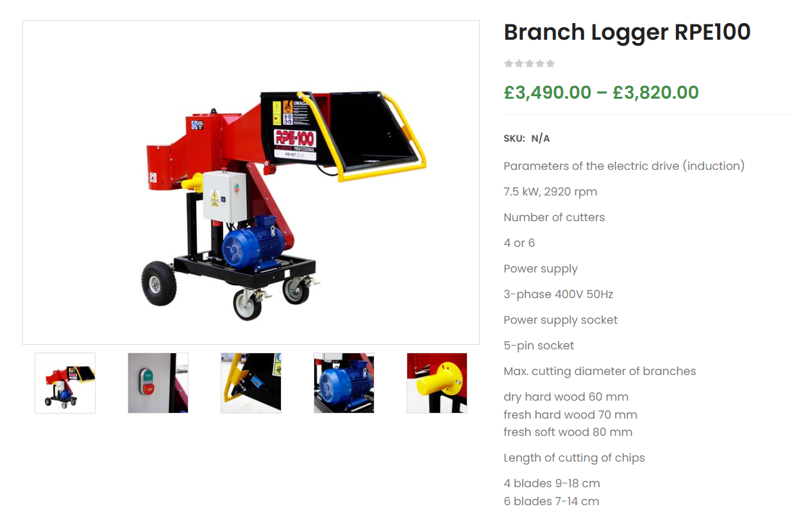
Rough Cost Analysis
Our design competes with premium machines (€3,000 - €5,000).
By manufacturing the chassis/cutter in-house, our component cost will be a fraction of this retail price.

Slide 18
Project Plan: Future Work
Phase 1: Detailed CAD Modeling
Model the 400mm cutter disc, 35mm main shaft, and sheet metal frame.
Phase 2: Component Sourcing
Download 3D models for the SEVA-tec motor, standard taper-lock pulleys (SPZ 106/212), and bearings (for 35mm shaft).
Phase 3: Analysis & Assembly
Run shaft analysis (FEA) using the 1158 N bending load and 49.2 Nm torque. Confirm bearing selection.
Phase 4: Safety & Finalization
Model all safety guards (belt guard, infeed/outfeed hoppers) and create final manufacturing drawings and report.

Slide 19

Thank you for your attention.

